Slide 1

Innopolis University
Control Theory (Linear Control)
Lecture 5
MIMO, LTI, LTV Systems
Sergei Savin, PhD
Slides design by Marko Pezer & Artem Bakhanov

Slide 2
Topic of the Lecture
Multi-Input Multi-Output (MIMO) Systems
Linear Time-Invariant (LTI) Systems
Linear Time-Variant (LTV) Systems
Equilibrium Points
Control Theory (Linear Control)
Slide 2

Slide 3
Multi-Input Multi-Output (MIMO) Systems (1/2)
Multi-input multi-output (MIMO) is an antenna technology for wireless communications in which multiple antennas are used at both the source and the destination.
MIMO is one of several forms of smart antenna technology, the others being multi-input single-output (MISO) and single-input multiple-output (SIMO).
Control Theory (Linear Control)
Slide 3

Slide 4
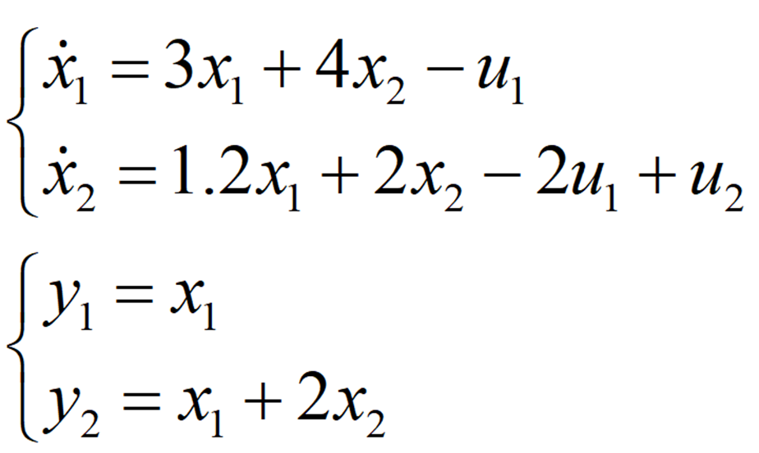
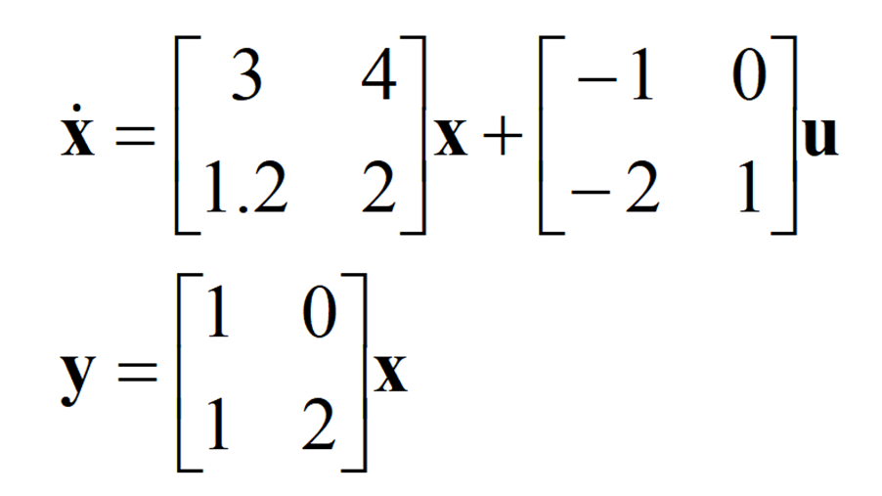
Multi-Input Multi-Output (MIMO) Systems (2/2)
Control Theory (Linear Control)
Slide 4

Slide 5
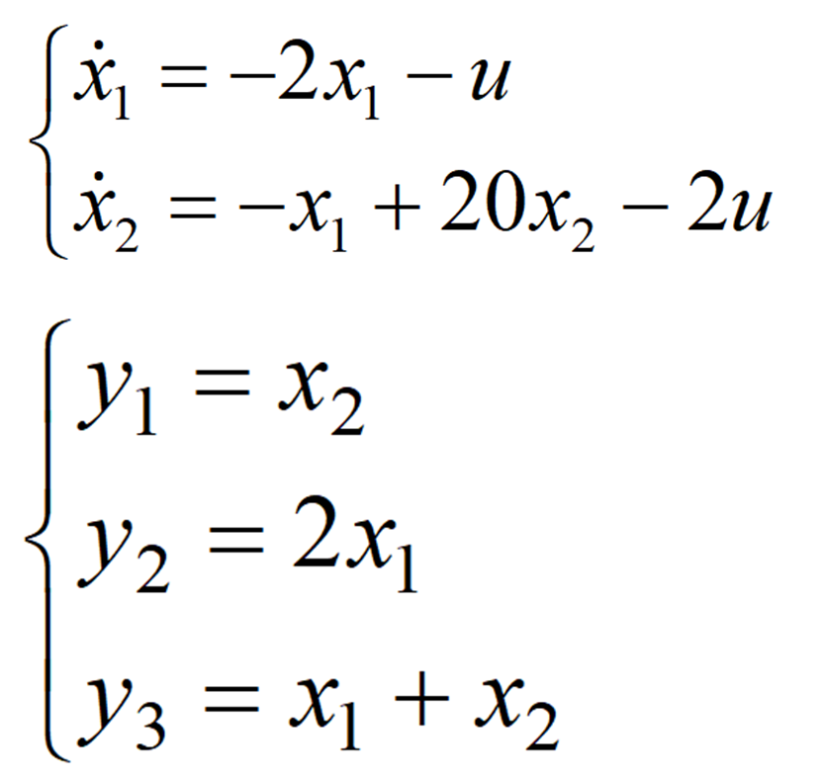
Single-Input Multiple-Output (SIMO): Example
Control Theory (Linear Control)
Slide 5

Slide 6
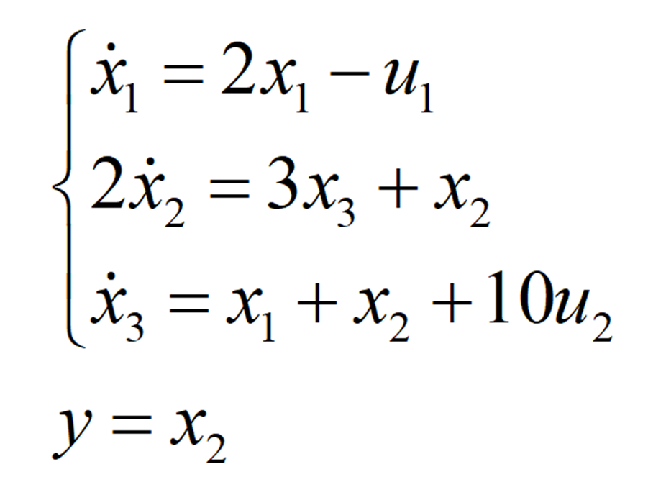
Multiple-Input Single-Output (MISO): Example
Control Theory (Linear Control)
Slide 6

Slide 7
Linear Time-Invariant (LTI) Systems (1/2)
Linear time-invariant (LTI) systems are a class of systems used in signals and systems that are both linear and time-invariant.
Linear systems are systems whose outputs for a linear combination of inputs are the same as a linear combination of individual responses to those inputs.
Time-invariant systems are systems where the output does not depend on when an input was applied.
Control Theory (Linear Control)
Slide 7

Slide 8

Linear Time-Invariant (LTI) Systems (2/2)
What topics will we consider?
Stability criteria
Phase portraits (state space trajectories/orbits)
What control does to phase portraits
Control Theory (Linear Control)
Slide 8

Slide 9
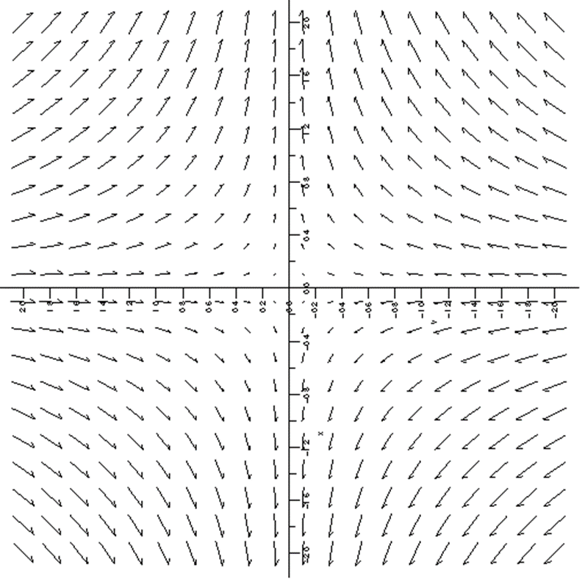
LTI Systems Phase Portrait (Flow Diagram)
Control Theory (Linear Control)
Slide 9

Slide 10
Linear Time-Variant (LTV) Systems (1/2)
Linear time-variant (LTV) systems are a class of systems used in signals and systems that are both linear and time-variant.
Linear systems are systems whose outputs for a linear combination of inputs are the same as a linear combination of individual responses to those inputs.
Time-variant systems are systems where the output depends on when an input was applied.
Control Theory (Linear Control)
Slide 10

Slide 11
Linear Time-Variant (LTV) Systems (2/2)
What topics will we consider?
How is stability criteria different?
What do phase portraits mean?
Control Theory (Linear Control)
Slide 11

Slide 12
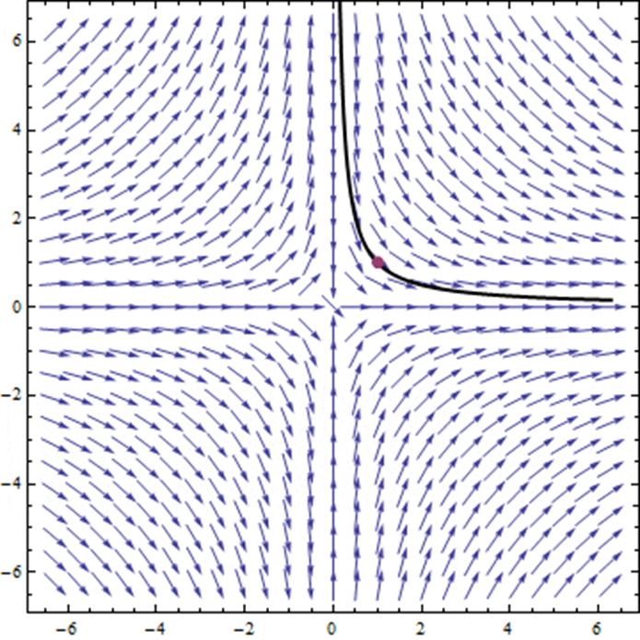
LTV Systems Phase Portrait (Flow Diagram)
Control Theory (Linear Control)
Slide 12

Slide 13

Equilibrium Points
Control Theory (Linear Control)
Slide 13

Slide 14
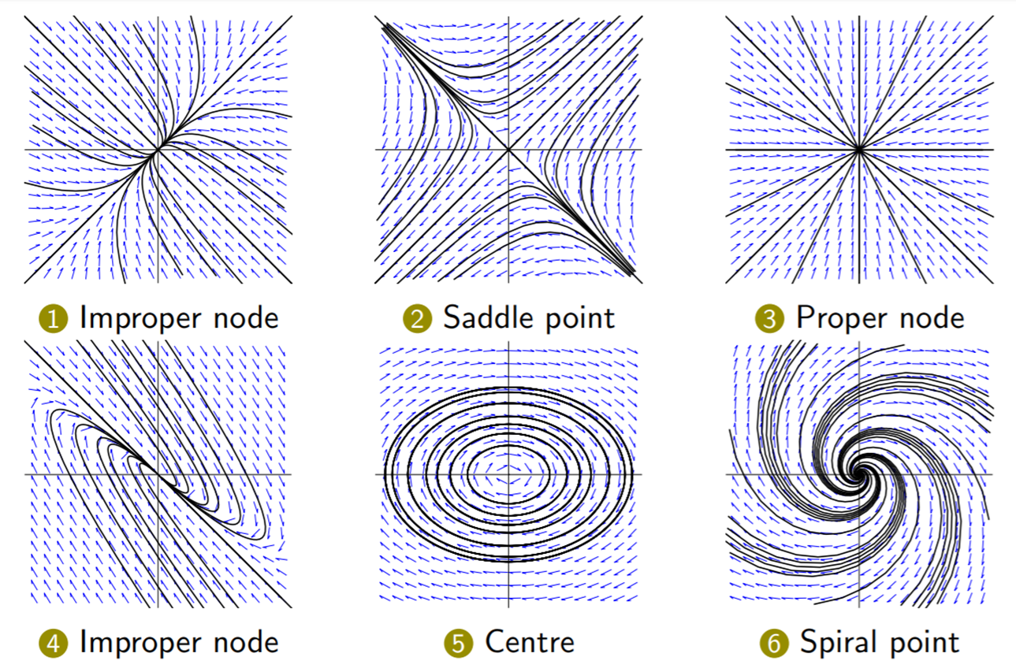
Phase Portraits of Linear Systems
Control Theory (Linear Control)
Slide 14

Slide 15
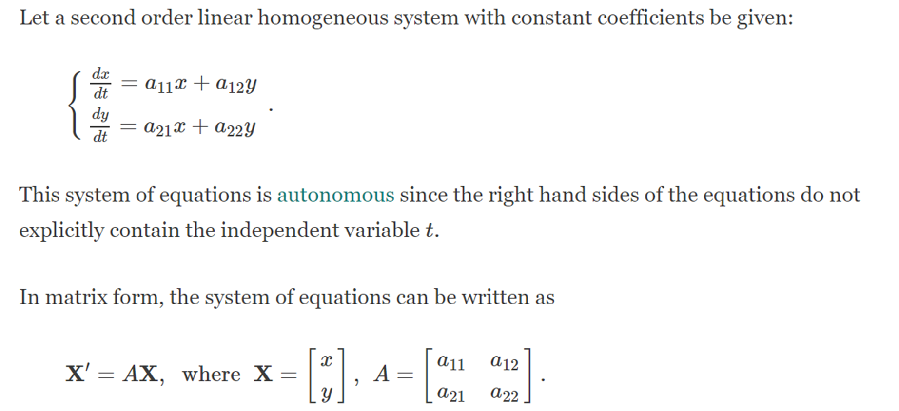
Types of Equilibrium Points (1/6)
Source:
https://www.math24.net/linear-autonomous-systems-equilibrium-points/
Control Theory (Linear Control)
Slide 15

Slide 16
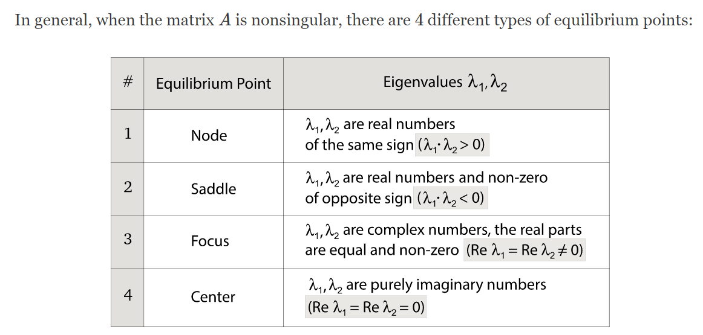
Types of Equilibrium Points (2/6)
Control Theory (Linear Control)
Slide 16

Slide 17
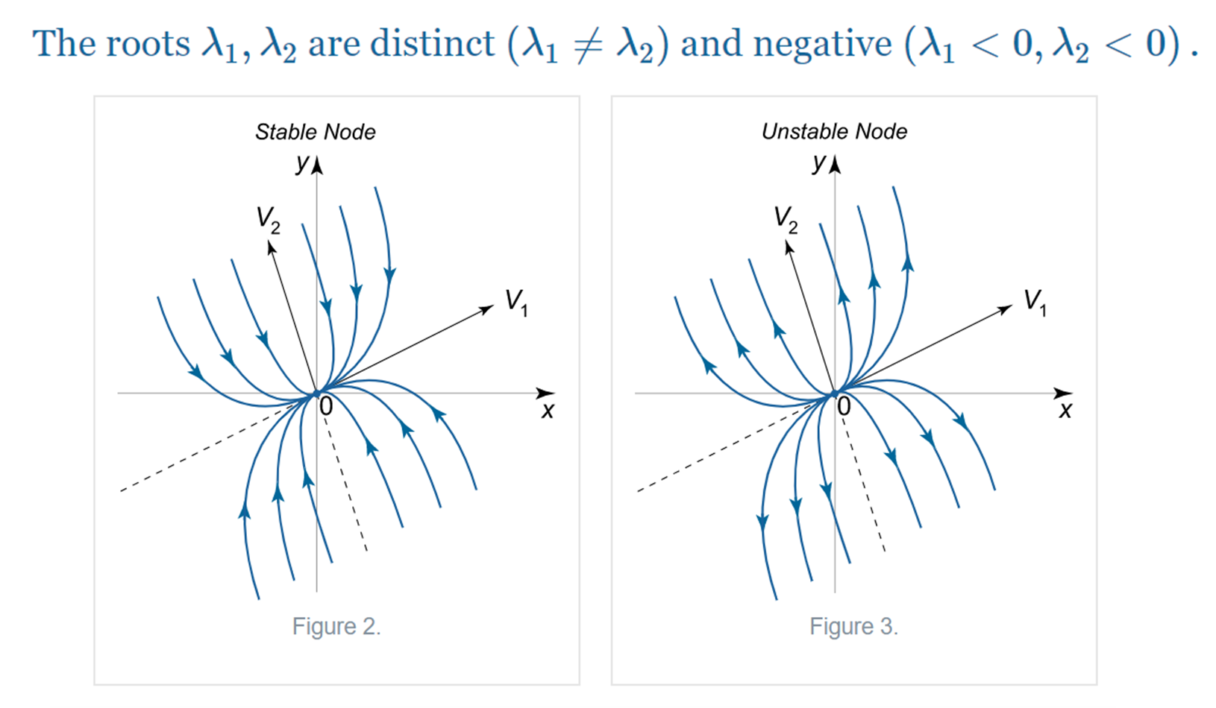
Types of Equilibrium Points (3/6)
Control Theory (Linear Control)
Slide 17

Slide 18
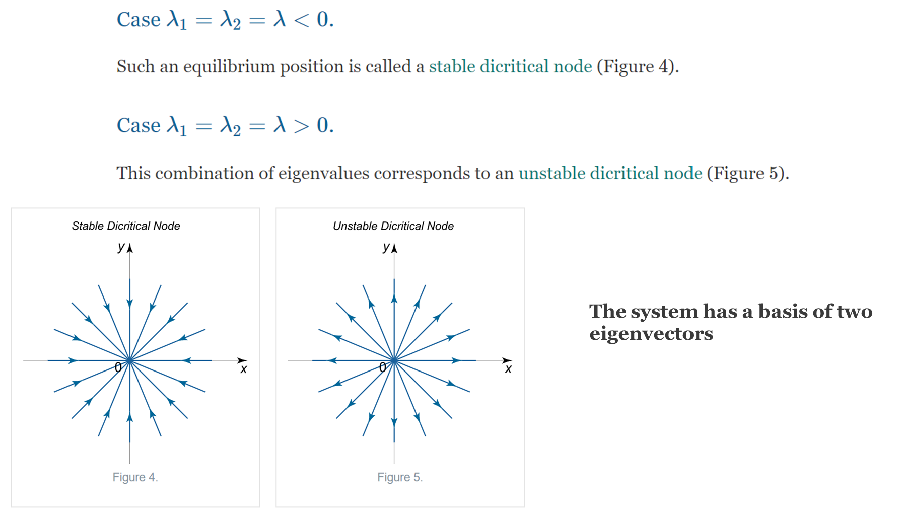
Types of Equilibrium Points (4/6)
Control Theory (Linear Control)
Slide 18

Slide 19
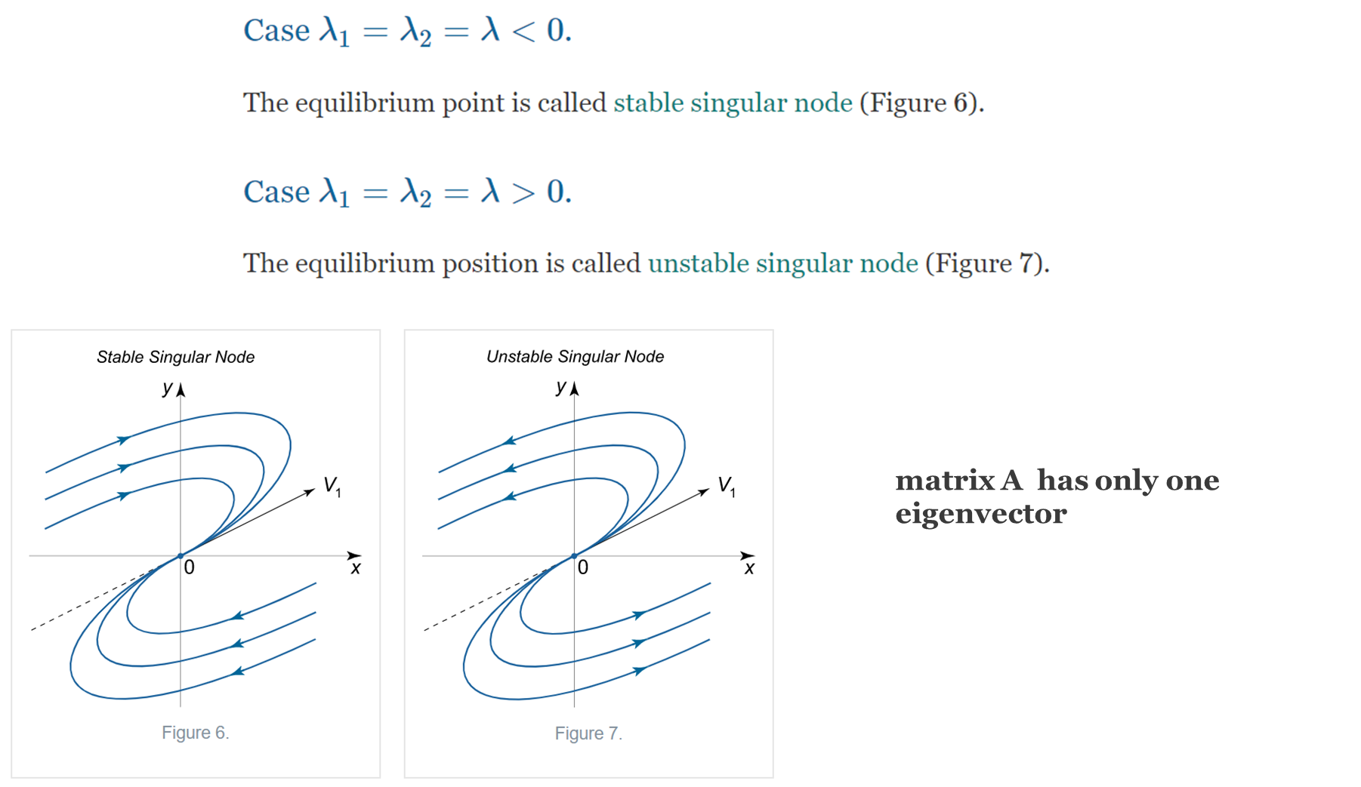
Types of Equilibrium Points (5/6)
Control Theory (Linear Control)
Slide 19

Slide 20
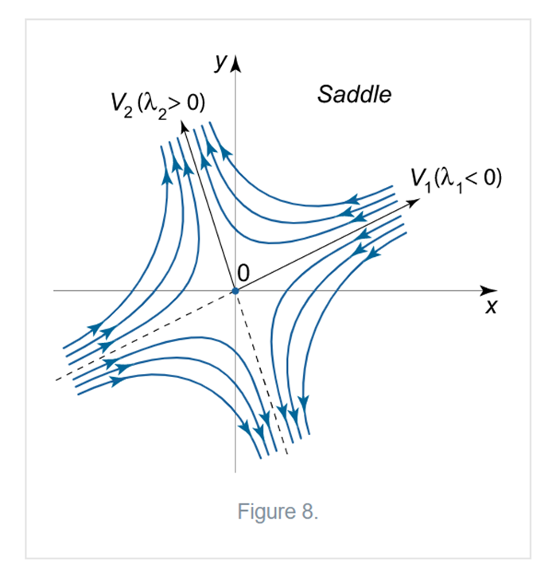
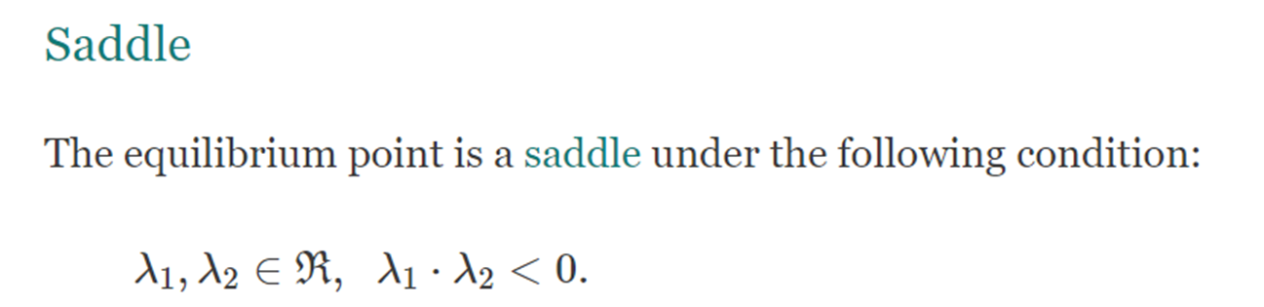
Types of Equilibrium Points (6/6)
Control Theory (Linear Control)
Slide 20

Slide 21
The End
Do you have any questions?

